Slide 1

International Conference on Computer Systems and Technologies CompSysTech'11 16-17 June 2011, Vienna University of Technology, Vienna, Austria
Depth Estimation using Shifted Digital Still Camera
Iva Nikolova, Assist. Prof., TU-Sofia, Bulgaria
Atanas Nikolov, Ph.D. student, BAS, Bulgaria
Georgi Zapryanov, Assist. Prof., TU-Sofia, Bulgaria

Slide 2
Depth Estimation using Shifted Digital Still Camera
Тhe present work’s objective is to investigate the possibilities of а simple method for acquiring the depth using the principles of a canonical stereo vision system.
The aim is to prove by physical experiments, using conventional digital still camera, when a real stereovision system is not available, is possible to effectively determine the z coordinates to particular object points in a given static scene.
The main requirement is that the camera should have precise horizontal movement, high resolution and possibilities for adjusting the parameters of its optical system.
Notes:
The aim of the present work is to investigate a simple approach for determining the distance to particular object points in a static scene, using the principles of the canonical stereovision systems, when a real one is not available. We used a conventional digital still camera, which is horizontally shifted by definite distance from its initial position.

Slide 3
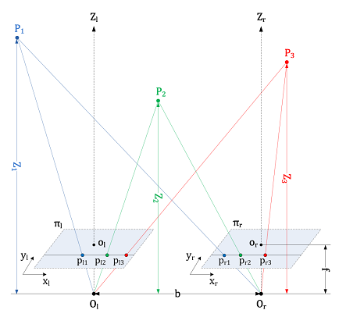
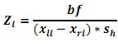
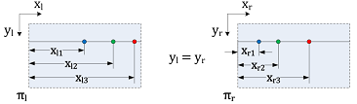
Geometrical Model of a Canonical Stereo Configuration
Parameters of a CSC:
(1) O_{l} and O_{r} - optical centers of the cameras; (2) Z_{l} and Z_{r} - parallel principal axes that pass through points O_{l} and O_{r} which are perpendicular to the image planes π_{l} and π_{r}; (3) base length, b - the distance between the points O_{l} and O_{r}; (4) focal length, f - the distance from the image planes to the central points O_{l} and O_{r}; (5) p_{li} and p_{ri} - the projections of an arbitrary point P_{i} within the scene on the image planes π_{l} and π_{r}; (6) x_{li} and x_{ri} - distances, measured from the top left corner of the images to the corresponding projections of a given point P_{i} (p_{li} and p_{ri}); (7) Z_{i} - the distance between the line connecting the optical centers of the cameras and the scene point P_{i}.
Geometrical model of a canonical stereo configuration
Notes:
One Stereovision system is canonical if it’s composed of two cameras with parallel principal axes and coplanar image planes, horizontally shifted by a definite distance, so that the corresponding projection of each 3D point from the scene belongs to the same horizontal line from the image planes.
The problem of determining the distance to objects in a scene by such a canonical stereovision configuration, is to find the horizontal displacement length (disparity) between two corresponding image points.
For given disparity x_{l} - x_{r} , the base length (b) between the cameras, the focal length (f) and the horizontal pixel size of the cameras’ sensors, is easy to find the distance to the scene points in world coordinates, according to this equation.

Slide 4
Depth Estimation Algorithm
The main problem in determining the distance to objects in a scene from a pair of stereo images, obtained by a canonical stereo configuration, is to find pairs of corresponding image points, which represent projection of one point from a 3D scene.
Step 1: Features detection in the stereo images by cornerness measure, proposed by Alison Noble, on the basis of the Harris corner detector.
Step 2: Searching for matches by the method of normalized cross correlation between the previously found feature points (corners).
Step 3: Depth estimation using the relationship between disparity, base length and focal length, obtained on the basis of the geometrical model of a canonical stereo configuration.

Slide 5
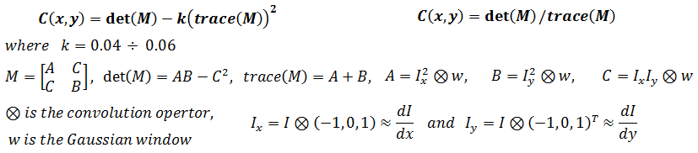
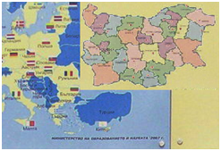
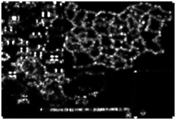
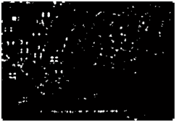
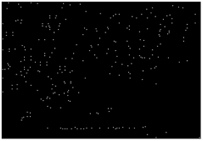
Corners Detection
Harris cornerness measure
A. Noble cornerness measure
Input Image
Cornerness Map
Thresholded Map
Corners
Apply Corner Operator
Threshold Cornerness Map
Non-maximal Suppression
Notes:
A procedure for corner detection is shown here. It can be stated in 3 major steps. First - the corner operator is applied to the input image and after that cornerness map is received. Then definite threshold is applied to the cornerness map. And finally non-maximal suppression is applied to the thresholded map and the remaining points are the searched corners.

Slide 6
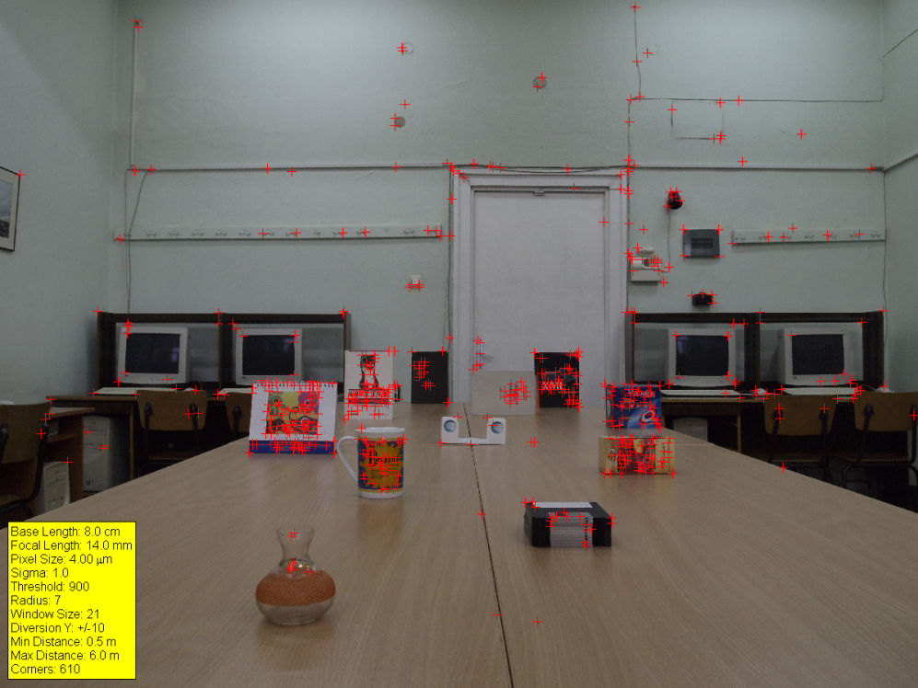
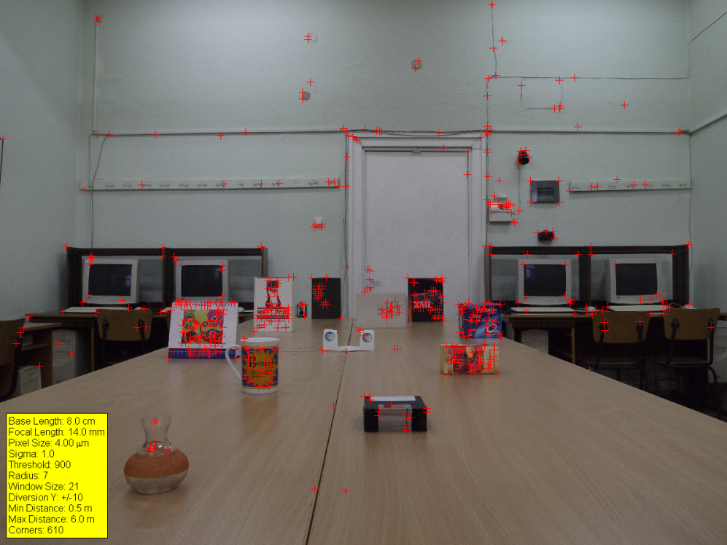
An Example of Found Corners in a Pair of Stereo Images

Slide 7
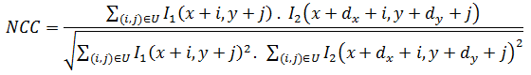
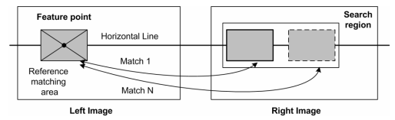
Searching for Matches
The metric used to determine which features in the stereo pair correspond to each other is based on Normalized Cross-Correlation:
where: I₁ and I₂ are two image regions being compared. The region I₁ is built around a reference point (x , y), and the region I₂ - around point (x+d_{x} , y+d_{y}), where with d_{x} and d_{y} are denoted the relative horizontal and vertical displacements of the two image blocks being compared. The matching regions are defined by a set U of offset values, measured from their reference points, i.e. (x , y) and (x+d_{x} , y+d_{y}), respectively.
Notes:
This slide represents, measuring the degree of correlation between previously detected corners in stereo images. For the best match evaluation, groups of pixels (neighborhoods) are taken simultaneously for comparison, instead of comparing single pixels. In the case of horizontally shifted images, the search can be restricted to horizontal displacements only.

Slide 8
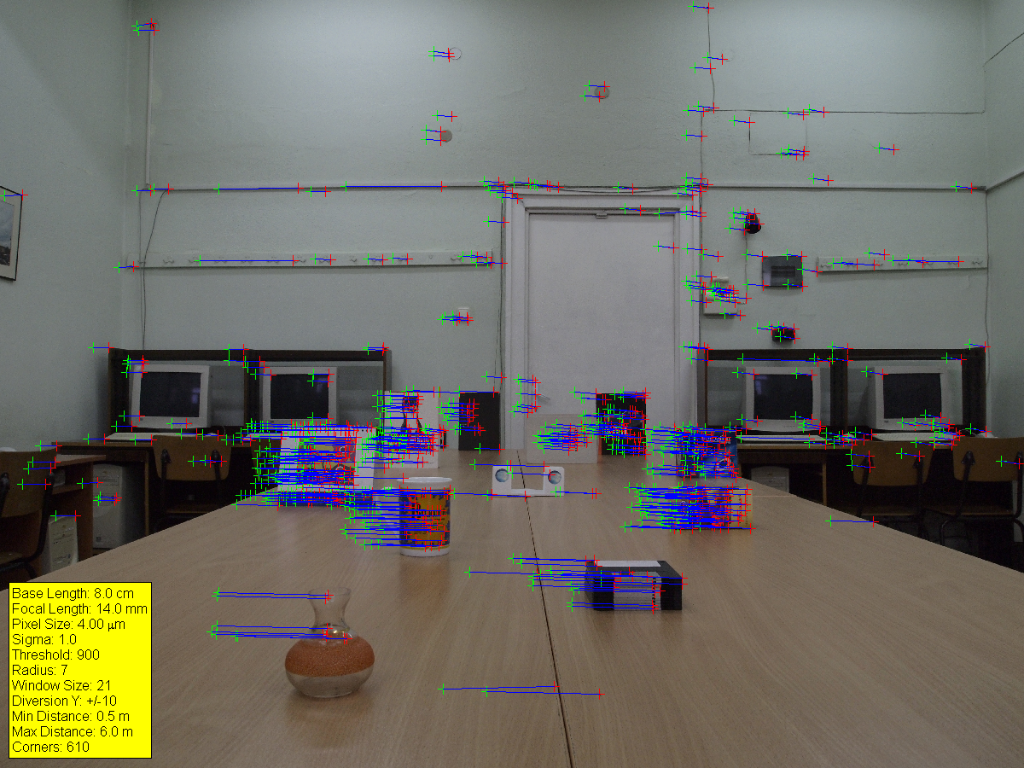
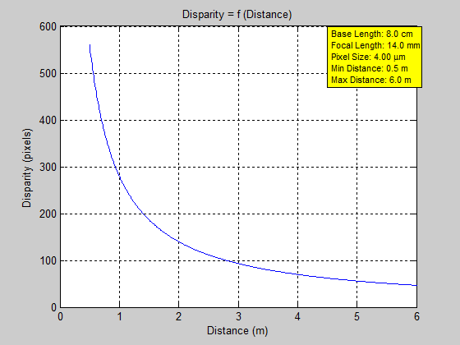
An Example of Found Correspondences Between Previously Detected Corners
Notes:
The last step of the distance estimation process requires determining the disparity using the corners’ correspondences and then performing disparity-to-depth conversion. The displacement length varies depending on the distance at which there is a point in the 3D space. Less distance means larger displacement and vice versa, i.e. the relationship between the distance and the horizontal displacement between the corresponding points is inversely proportionable.

Slide 9
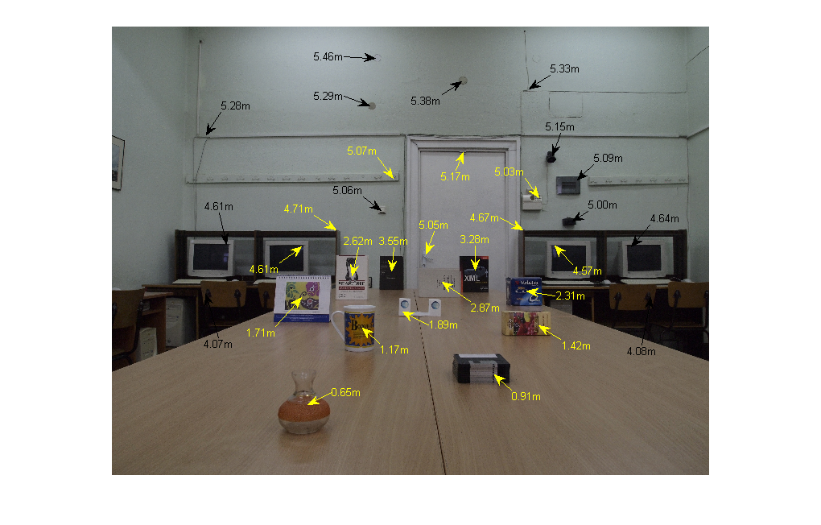
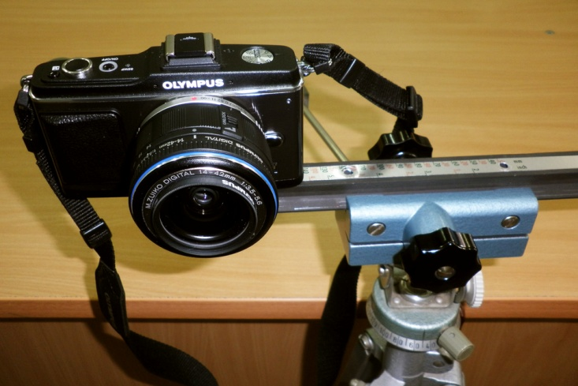
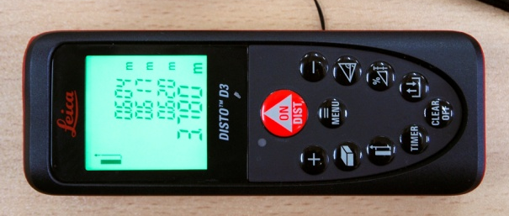
Experimental Results
Our experimental work has two goals:
1) to verify the applicability of the mathematical model, using a real camera system;
2) to test the accuracy of the estimated distances in a real scene.
Experimental Platform
Real Distances to selected objects
Laser distancemeter
Notes:
The experiments are conducted using one digital still camera mounted on a platform that provides an opportunity for horizontal translation by specific distances.
Each of the experiments was made with series of 6 photos: the first picture is taken on chosen starting position, while for the remaining five the camera shifts to different base lengths - from 6 to 10 cm with step of 1 cm. During the experiments, besides the change of the starting position, the focal length was changed too.
The real distances to objects from the scene was previously measured using a laser distancemeter with measurement precision ± 1 mm, in order to be used as reference data to determine the evaluation accuracy.

Slide 10
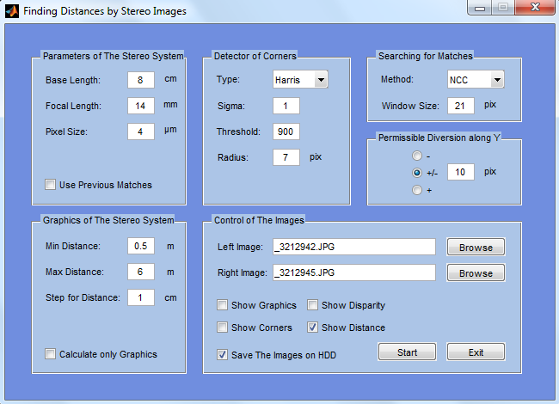
Interface of the Software application
Notes:
A software application for the purposes of experimental research was developed, which allows various parameters of the investigated algorithms to be specified (for example, the basic distance between a pair stereo images, the focal length, the pixel size, the minimum and the maximum distance at which to look for matches, the Harris corner detector settings, the size of the correlation window, and etc.) during the various stages of the depth estimation process.

Slide 11
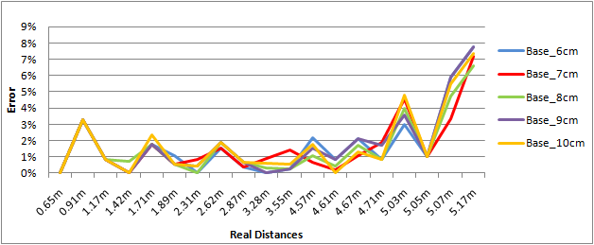
Experimental Results (f=14mm)
Real Distance | Base length between cameras with focal length 14 mm
 | 6cm |  |  | 7cm |  |  | 8cm |  |  | 9cm |  |  | 10cm
 | Est. [m] | Err [%] | Err [cm] | Est. [m] | Err [%] | Err [cm] | Est. [m] | Err [%] | Err [cm] | Est. [m] | Err [%] | Err [cm] | Est. [m] | Err [%] | Err [cm]
0.65m | 0.65m | 0.00% | 0cm | 0.65m | 0.00% | 0cm | 0.65m | 0.00% | 0cm | 0.65m | 0.00% | 0cm | 0.65m | 0.00% | 0cm
0.91m | 0.88m | 3.30% | 3cm | 0.88m | 3.30% | 3cm | 0.88m | 3.30% | 3cm | 0.88m | 3.30% | 3cm | 0.88m | 3.30% | 3cm
1.17m | 1.18m | 0.85% | 1cm | 1.18m | 0.85% | 1cm | 1.18m | 0.85% | 1cm | 1.18m | 0.85% | 1cm | 1.18m | 0.85% | 1cm
1.42m | 1.42m | 0.00% | 0cm | 1.42m | 0.00% | 0cm | 1.41m | 0.70% | 1cm | 1.42m | 0.00% | 0cm | 1.42m | 0.00% | 0cm
1.71m | 1.74m | 1.75% | 3cm | 1.74m | 1.75% | 3cm | 1.74m | 1.75% | 3cm | 1.74m | 1.75% | 3cm | 1.75m | 2.34% | 4cm
1.89m | 1.91m | 1.06% | 2cm | 1.90m | 0.53% | 1cm | 1.90m | 0.53% | 1cm | 1.90m | 0.53% | 1cm | 1.90m | 0.53% | 1cm
2.31m | 2.31m | 0.00% | 0cm | 2.33m | 0.87% | 2cm | 2.31m | 0.00% | 0cm | 2.32m | 0.43% | 1cm | 2.30m | 0.43% | 1cm
2.62m | 2.66m | 1.53% | 4cm | 2.66m | 1.53% | 4cm | 2.67m | 1.91% | 5cm | 2.67m | 1.91% | 5cm | 2.67m | 1.91% | 5cm
2.87m | 2.88m | 0.35% | 1cm | 2.88m | 0.35% | 1cm | 2.89m | 0.70% | 2cm | 2.89m | 0.70% | 2cm | 2.89m | 0.70% | 2cm
3.28m | 3.28m | 0.00% | 0cm | 3.31m | 0.91% | 3cm | 3.29m | 0.30% | 1cm | 3.28m | 0.00% | 0cm | 3.30m | 0.61% | 2cm
3.55m | 3.56m | 0.28% | 1cm | 3.60m | 1.41% | 5cm | 3.54m | 0.28% | 1cm | 3.54m | 0.28% | 1cm | 3.57m | 0.56% | 2cm
4.57m | 4.47m | 2.19% | 10cm | 4.54m | 0.66% | 3cm | 4.52m | 1.09% | 5cm | 4.50m | 1.53% | 7cm | 4.49m | 1.75% | 8cm
4.61m | 4.57m | 0.87% | 4cm | 4.62m | 0.22% | 1cm | 4.59m | 0.43% | 2cm | 4.57m | 0.87% | 4cm | 4.61m | 0.00% | 0cm
4.67m | 4.57m | 2.14% | 10cm | 4.62m | 1.07% | 5cm | 4.59m | 1.71% | 8cm | 4.57m | 2.14% | 10cm | 4.61m | 1.28% | 6cm
4.71m | 4.67m | 0.85% | 4cm | 4.62m | 1.91% | 9cm | 4.67m | 0.85% | 4cm | 4.63m | 1.70% | 8cm | 4.67m | 0.85% | 4cm
5.03m | 4.88m | 2.98% | 15cm | 4.80m | 4.57% | 23cm | 4.83m | 3.98% | 20cm | 4.85m | 3.58% | 18cm | 4.79m | 4.77% | 24cm
5.05m | 5.00m | 0.99% | 5cm | 5.00m | 0.99% | 5cm | 5.00m | 0.99% | 5cm | 5.00m | 0.99% | 5cm | 5.00m | 0.99% | 5cm
5.07m | 4.77m | 5.92% | 30cm | 4.90m | 3.35% | 17cm | 4.83m | 4.73% | 24cm | 4.77m | 5.92% | 30cm | 4.79m | 5.52% | 28cm
5.17m | 4.77m | 7.74% | 40cm | 4.80m | 7.16% | 37cm | 4.83m | 6.58% | 34cm | 4.77m | 7.74% | 40cm | 4.79m | 7.35% | 38cm
Notes:
The experimental results obtained, show that at focal length of 14 mm, higher accuracy is observed at distances up to 4.7 m - the error is below 3%, while, with increasing the distance, the error reaches to 8%.

Slide 12
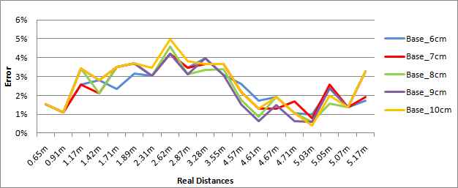
Experimental Results (f=20mm)
Real Distance | Base length between cameras with focal length 20 mm
 | 6cm |  |  | 7cm |  |  | 8cm |  |  | 9cm |  |  | 10cm
 | Est. [m] | Err [%] | Err. [cm] | Est. [m] | Err [%] | Err [cm] | Est. [m] | Err [%] | Err [cm] | Est. [m] | Err [%] | Err [cm] | Est. [m] | Err [%] | Err [cm]
0.65m | 0.66m | 1.54% | 1cm | 0.66m | 1.54% | 1cm | 0.66m | 1.54% | 1cm | 0.66m | 1.54% | 1cm | 0.66m | 1.54% | 1cm
0.91m | 0.90m | 1.10% | 1cm | 0.90m | 1.10% | 1cm | 0.90m | 1.10% | 1cm | 0.90m | 1.10% | 1cm | 0.90m | 1.10% | 1cm
1.17m | 1.20m | 2.56% | 3cm | 1.20m | 2.56% | 3cm | 1.21m | 3.42% | 4cm | 1.21m | 3.42% | 4cm | 1.21m | 3.42% | 4cm
1.42m | 1.46m | 2.82% | 4cm | 1.45m | 2.11% | 3cm | 1.45m | 2.11% | 3cm | 1.46m | 2.82% | 4cm | 1.46m | 2.82% | 4cm
1.71m | 1.75m | 2.34% | 4cm | 1.77m | 3.51% | 6cm | 1.77m | 3.51% | 6cm | 1.77m | 3.51% | 6cm | 1.77m | 3.51% | 6cm
1.89m | 1.95m | 3.17% | 6cm | 1.96m | 3.70% | 7cm | 1.96m | 3.70% | 7cm | 1.96m | 3.70% | 7cm | 1.96m | 3.70% | 7cm
2.31m | 2.38m | 3.03% | 7cm | 2.38m | 3.03% | 7cm | 2.38m | 3.03% | 7cm | 2.38m | 3.03% | 7cm | 2.39m | 3.46% | 8cm
2.62m | 2.73m | 4.20% | 11cm | 2.73m | 4.20% | 11cm | 2.74m | 4.58% | 12cm | 2.73m | 4.20% | 11cm | 2.75m | 4.96% | 13cm
2.87m | 2.97m | 3.48% | 10cm | 2.97m | 3.48% | 10cm | 2.96m | 3.14% | 9cm | 2.96m | 3.14% | 9cm | 2.98m | 3.83% | 11cm
3.28m | 3.41m | 3.96% | 13cm | 3.40m | 3.66% | 12cm | 3.39m | 3.35% | 11cm | 3.41m | 3.96% | 13cm | 3.40m | 3.66% | 12cm
3.55m | 3.66m | 3.10% | 11cm | 3.68m | 3.66% | 13cm | 3.67m | 3.38% | 12cm | 3.66m | 3.10% | 11cm | 3.68m | 3.66% | 13cm
4.57m | 4.69m | 2.63% | 12cm | 4.67m | 2.19% | 10cm | 4.65m | 1.75% | 8cm | 4.64m | 1.53% | 7cm | 4.67m | 2.19% | 10cm
4.61m | 4.69m | 1.74% | 8cm | 4.67m | 1.30% | 6cm | 4.65m | 0.87% | 4cm | 4.64m | 0.65% | 3cm | 4.67m | 1.30% | 6cm
4.67m | 4.76m | 1.93% | 9cm | 4.73m | 1.28% | 6cm | 4.76m | 1.93% | 9cm | 4.74m | 1.50% | 7cm | 4.76m | 1.93% | 9cm
4.71m | 4.76m | 1.06% | 5cm | 4.79m | 1.70% | 8cm | 4.76m | 1.06% | 5cm | 4.74m | 0.64% | 3cm | 4.76m | 1.06% | 5cm
5.03m | 5.08m | 0.99% | 5cm | 5.07m | 0.80% | 4cm | 5.06m | 0.60% | 3cm | 5.00m | 0.60% | 3cm | 5.05m | 0.40% | 2cm
5.05m | 5.17m | 2.38% | 12cm | 5.18m | 2.57% | 13cm | 5.13m | 1.58% | 8cm | 5.17m | 2.38% | 12cm | 5.15m | 1.98% | 10cm
5.07m | 5.00m | 1.38% | 7cm | 5.00m | 1.38% | 7cm | 5.00m | 1.38% | 7cm | 5.00m | 1.38% | 7cm | 5.00m | 1.38% | 7cm
5.17m | 5.08m | 1.74% | 9cm | 5.07m | 1.93% | 10cm | 5.00m | 3.29% | 17cm | 5.00m | 3.29% | 17cm | 5.00m | 3.29% | 17cm
Notes:
(1) In increasing the focal length to 20 mm, the error is less than 5% for shorter distances, and below 3% for those more than 4.5 m.
(3) The conducted series of experiments, varying the base length from 6 cm to 10 cm, demonstrate that there are no significant changes in the achieved accuracy. As the pixel size cannot be changed effectively to make estimation improvements, the parameter that can be mainly tuned is the focal length. Any other opportunities for improvement of the depth estimation accuracy are: using of a high spatial resolution sensor (a small pixel size is preferable); increasing the distance between the cameras; increasing the focal length.

Slide 13
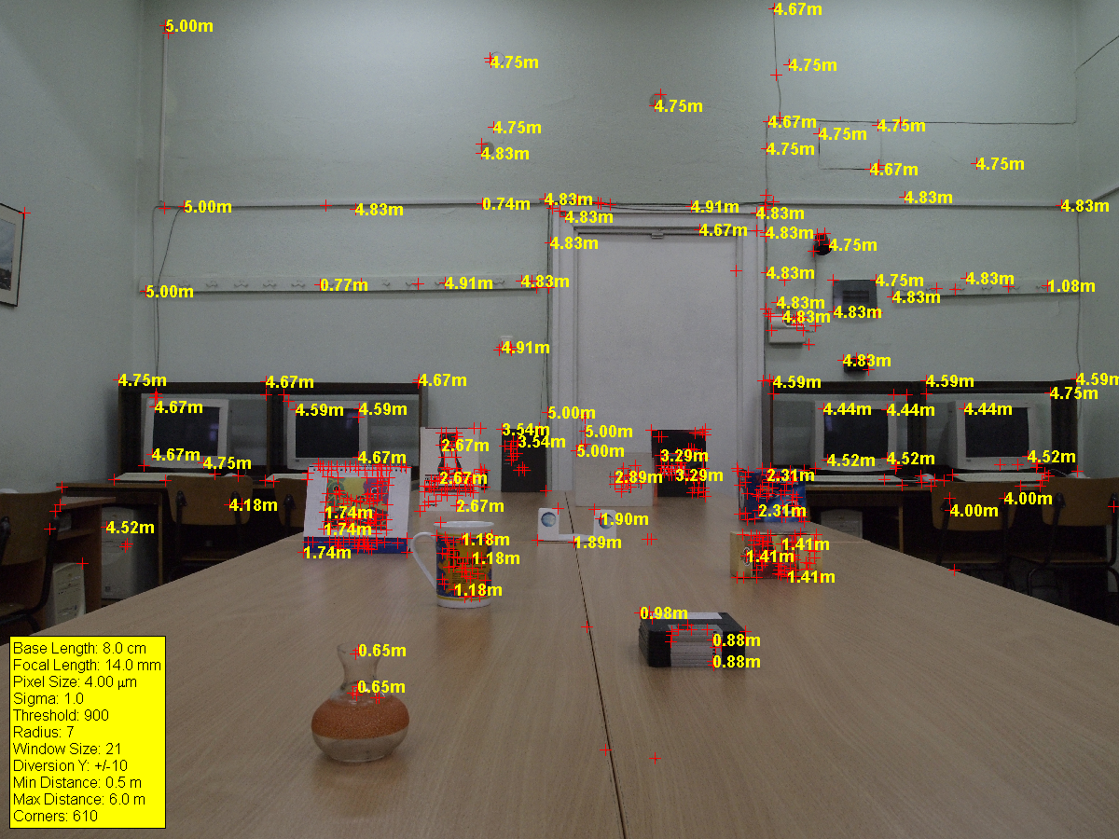
Depth Estimation to Definite Points
Notes:
(2) The accuracy of distance estimation is highest for objects located in the center of the frame for both shown focal lengths, due to the lack of optical distortions.

Slide 14
Conclusion and Future Work
The accuracy of the investigated method for distance determining to objects in a static scene by translation of one camera can be viewed from physical and algorithmic point:
For the physical accuracy improvement a subjective adjustments (like choice of optimal base and focal length, knowledge for optical distortions) need to be applied, in order to calibrate the stereovision system, according to the working distance range.
The algorithmic accuracy aspect depends on the software methods for determining the feature points (corners) and their correspondence.
The future development of the investigated method can be focused on:
Each point from the stereoimages to be viewed as a characteristic point and its correspondence to be found in the other image;
Determining the 3D coordinates (X, Y, Z) of a random point;
The distance determining algorithm should not require the usage of the canonical stereovision system model;
3D modeling and 3D object recognition.

Slide 15
THANK YOU FOR THE ATTENTION!
QUESTIONS?

